Slide 1
ANTI procrastination strategies
by
Prof. adejumoke inyinbor (duwc)

Slide 2
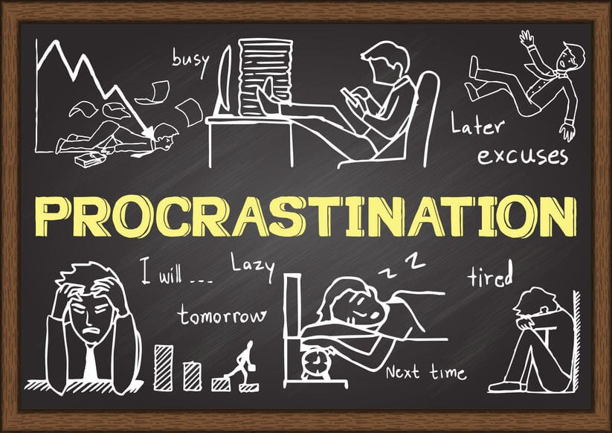
What is procrastination?
Procrastination is the act of delaying important tasks despite knowing the consequences.

Slide 3

"Procrastination is the grave in which opportunity is buried." ~ Author Unknown
Procrastination is the thief of time.
Putting things off robs us of the opportunity to accomplish something.
dictionary.com

Slide 4
Procrastination is the practice of carrying out less urgent tasks in preference to more urgent ones, or doing more pleasurable things in place of less pleasurable ones, and thus putting off impending tasks to a later time, sometimes to the “last minute” before a deadline.

Slide 5
reasons why people procrastinate
Poor time management or unwise time management
I must work the works of him that sent me, while it is day: the night cometh, when no man can work. John 9:4
Inability to prioritize

Slide 6


Slide 7
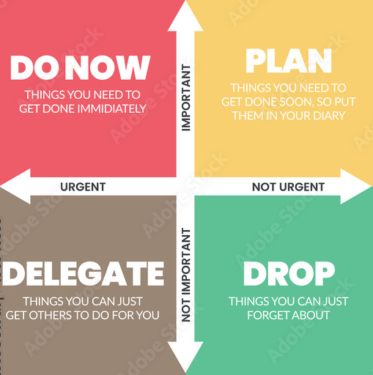
The 4 boxes of Eisenhower Matrix

Slide 8
But Martha was distracted with much serving, and she approached Him and said, “Lord, do You not care that my sister has left me to serve alone? Therefore tell her to help me.” And Jesus answered and said to her, “Martha, Martha, you are worried and troubled about many things. But one thing is needed, and Mary has chosen that good part, which will not be taken away from her.”
LUKE 10:40-42

Slide 9
Too many task at the same time
Anxiety or fear about the task - time is spent worrying rather than doing
Difficulty concentrating, perhaps because of other problems
Not knowing what is required of you in order to do the task
Feeling overwhelmed by the task
Negative mentality (mentality of not meeting standards set by self or others, of not being good enough)

Slide 10
Perfectionism, believing that anything short of perfect is a complete failure
Excuses (shortness of time)
Being bored by the task
Trying to avoid disliked or difficult task

Slide 11
Strategies for procrastination
Create a dedicated work space/ have a good structure
Ascribe spaces with specific activities putting into consideration what enhances your productivity.
Jesus, our perfect example:
Mark 1:35 Early in the morning, while it was still dark, Jesus got up and slipped out to a solitary place to pray.
Mathew 14:13a When Jesus heard about John, He withdrew by boat privately to a solitary place. (Luke 4:42 etc)
Luke 5:16 Yet He frequently withdrew to the wilderness to pray.

Slide 12
Commit to few minutes at a time
Often, starting the task is the challenge; therefore, commit to the task for few minutes (take a break and repeat)
Hold yourself accountable
(You can ask a friend or family member to check on you regarding some assignment)
Acts 15:16 And some days after Paul said unto Barnabas, Let us go again and visit our brethren in every city where we have preached the word of the Lord, and see how they do.

Slide 13
Create and Practice task management
Break projects into smaller tasks
Find supports
Assign tasks to daily ‘to-do’ lists

Slide 14
Build a routine
Regular routine reduces procrastination
Make your routine visual
Make your routine achievable and realistic

Slide 15
The ability to concentrate single-mindedly on your most important task, to do it well and to finish it completely, is the key to great success, achievement, respect, status and happiness in life.
BRIAN TRACY

Slide 16
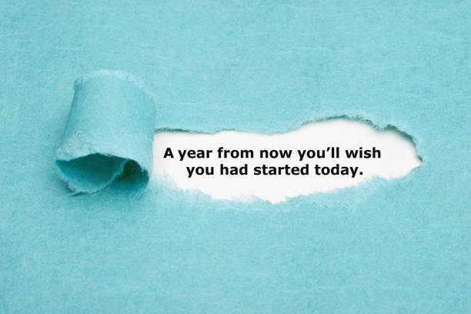
Are you pushing an important task forward? Start now because

